Slide 1


HOSPITAL MANAGMENT SYSTEM
Tayyaba Saeed-8644
Jaweria Afzal- 8586
01
02

Slide 2


Overview
Welcome to our Hospital Management System!
It's like a helpful assistant for hospitals. The project includes multiple Windows Forms Welcome, Login, Home, Doctor, Patient, and Diagnosis forms. Each form has a distinct role, covering authentication, navigation, and data management for doctors, patients, and diagnoses. It's designed to make hospital life simpler, so doctors and nurses can spend more time caring for patients and less time on paperwork.

Slide 3
FEATURES
HOSPITAL MANAGEMENT SYSTEM
Data Management
Authentication System
Authentication System: The application begins with a login form where users are required to enter their username and password. If the credentials match, users are directed to the home page; otherwise, an error message is displayed.
Navigation: Once logged in, users can navigate through different sections of the application using buttons. Sections include Home, Doctor, Patient, and Diagnosis.
Data Management: Each section (Doctor, Patient, Diagnosis) allows users to perform CRUD operations (Create, Read, Update, Delete) on respective data tables stored in Access databases (Doctor.accdb, Patient.accdb, Diagnosis.accdb).
User Interface: The UI is designed using Windows Forms controls like buttons, textboxes, labels, DataGrid views, etc. It provides a user-friendly interface for interacting with the application.
Feautures
Of HMS
User
Interface
Navigation

Slide 4

Functionalities:
Login: Users must authenticate themselves using a username and password to access the system. Invalid credentials result in an error message.
Navigation: Users can move between different sections of the application using navigation buttons.
Data Management:
1. Doctor Section: Users can add, update, and delete doctor records.
2. Patient Section: Users can add, update, and delete patient records.
3. Diagnosis Section: Users can add, update, and delete diagnosis records.
Data Display: Data from the databases is displayed in DataGrid Views, allowing users to view records easily.

Slide 5
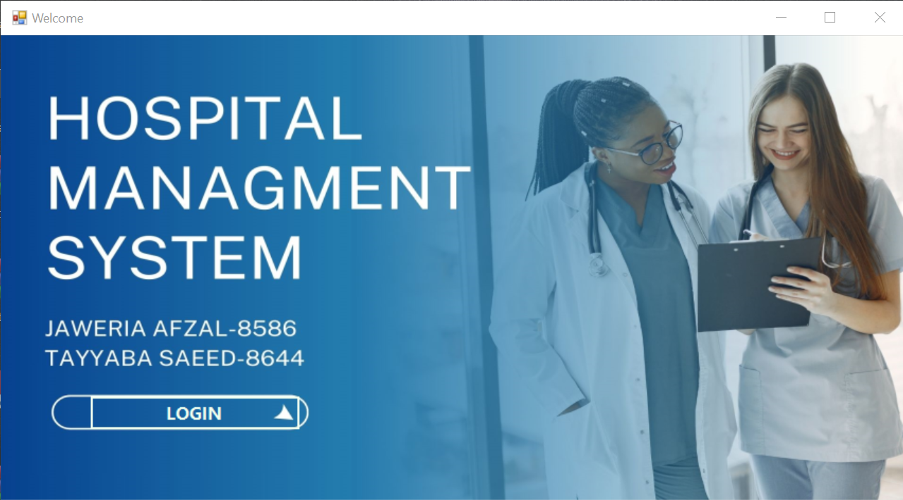
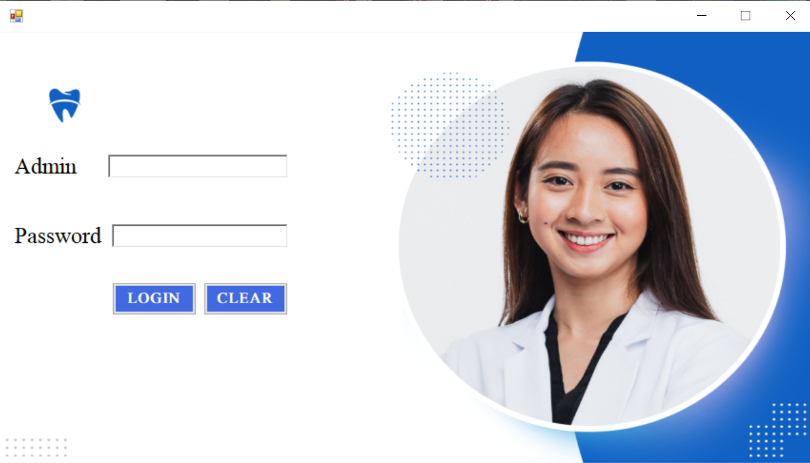
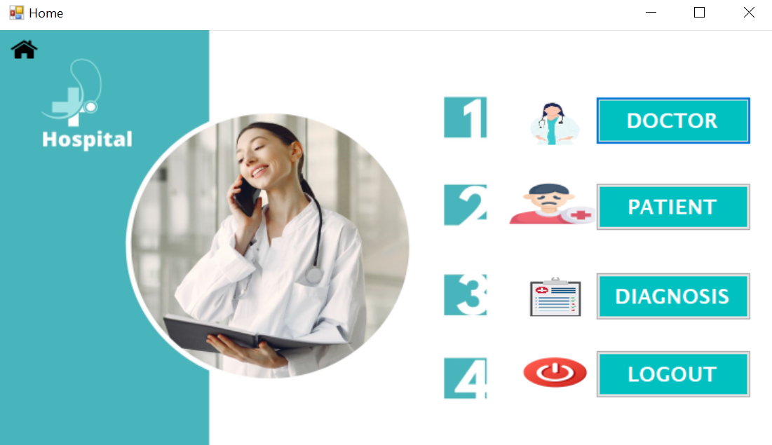
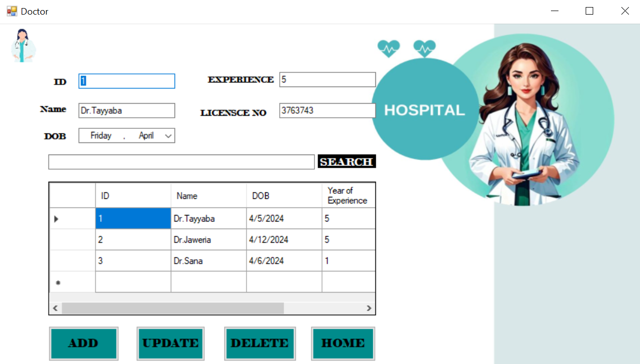
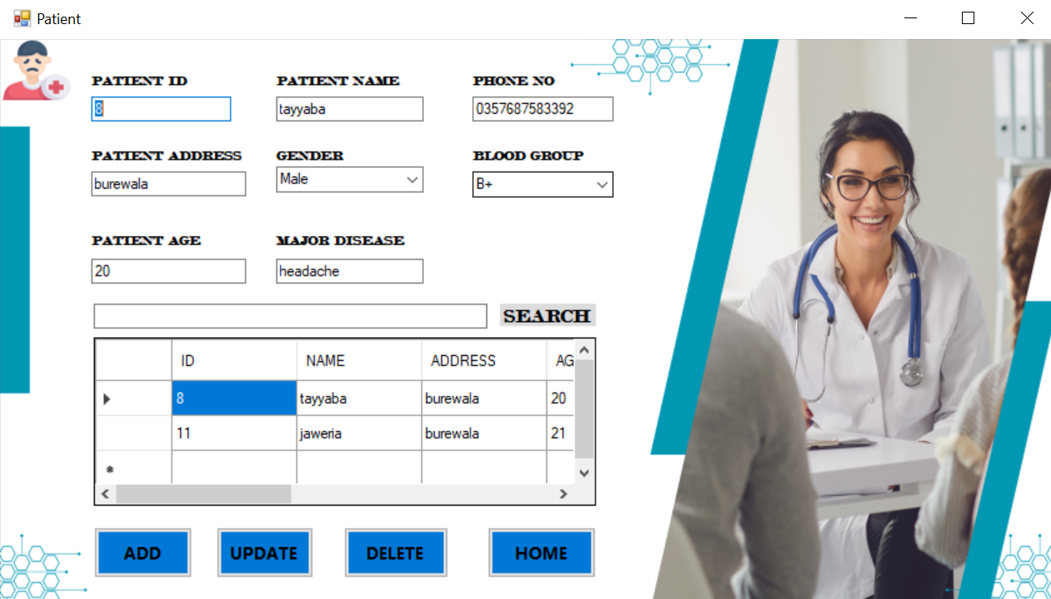
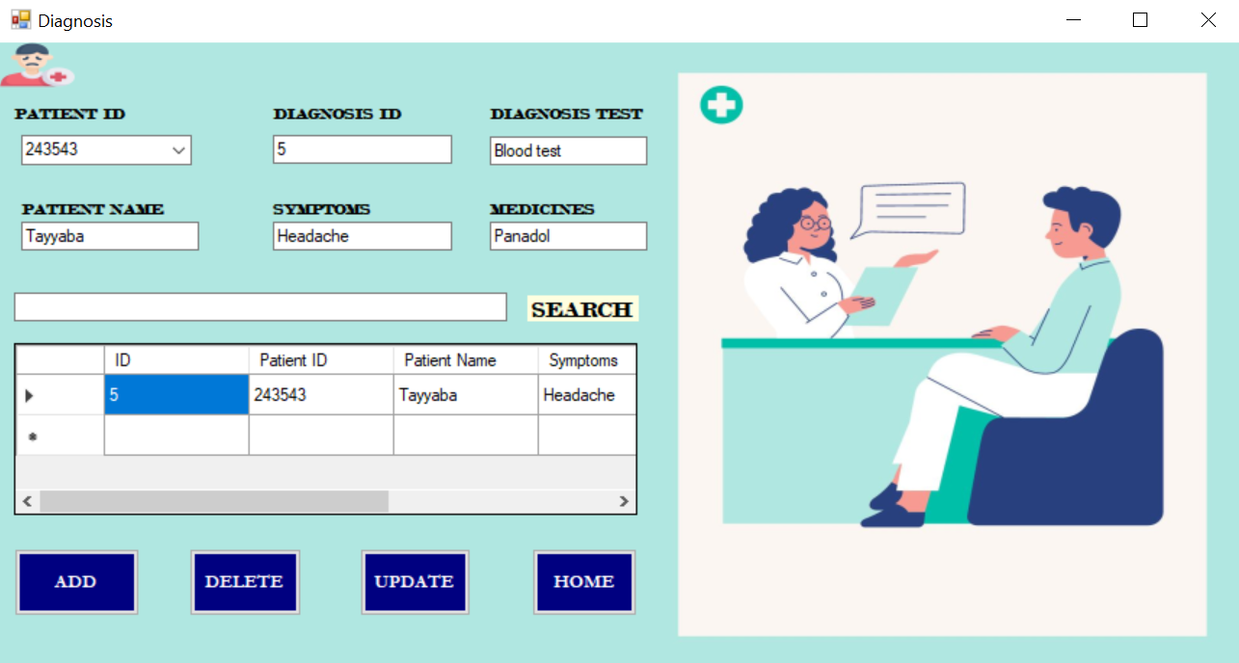

Slide 6



ADVANTAGES
Modular Design: The project is organized into modular forms, enhancing code readability and maintainability.
Database Integration: Integration with Access databases facilitates data storage and management, ensuring data persistence and accessibility.
User-Friendly UI: The Windows Forms UI offers a familiar and intuitive interface for users to interact with the application easily.
CRUD Functionality: Users can perform CRUD operations on doctor, patient, and diagnosis data, improving data management efficiency.
Error Handling: Basic error handling is implemented, enhancing user experience by providing informative feedback.
Event-Driven Programming: Utilizing event handlers for control actions enables responsive user interactions and efficient code execution.
DISADVANTAGES
1.Initial Setup: Setting up the system needs time, effort, and training for staff. It's like getting everything ready before you start using it.
2.Dependency on Technology: If the system has problems or stops working, it can slow down work and affect patient care. So, having good tech support and reliable equipment is really important.

Slide 7

CONCUSION
The Hospital Management System provides basic functionalities for managing doctors, patients, and diagnoses.
However, it requires further refinement to meet production standards, including database integration and enhanced user experience.
Overall, it serves as a foundational codebase but needs enhancements for robustness and usability.

Slide 8

ANY QUESTION

Slide 9


